Slide 1
Hierarchical Clustering
by Joshi, Akhilesh Diliprao

Slide 2
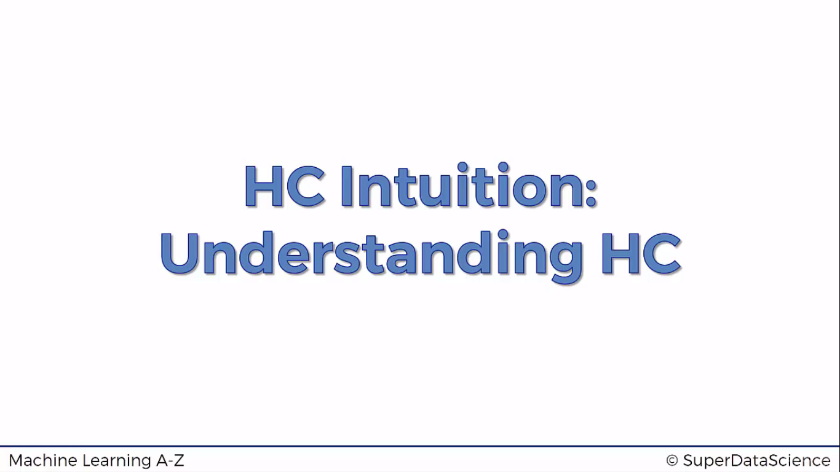

Slide 3
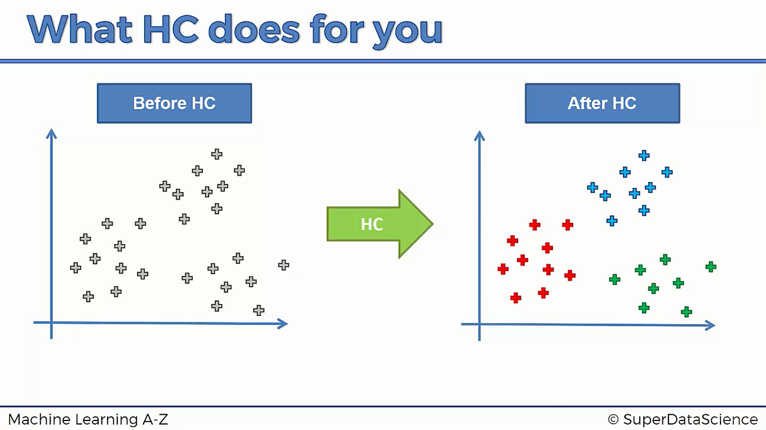

Slide 4
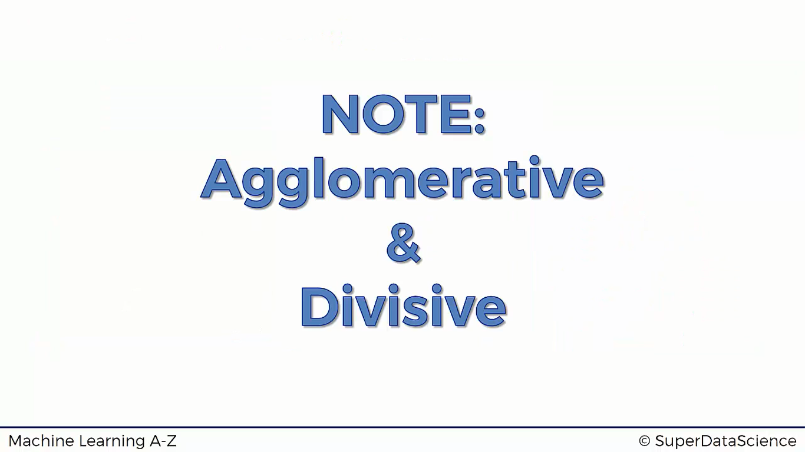
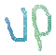
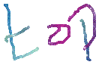
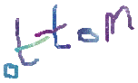
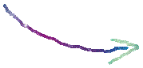
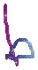
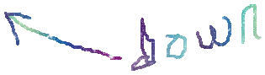

Slide 5
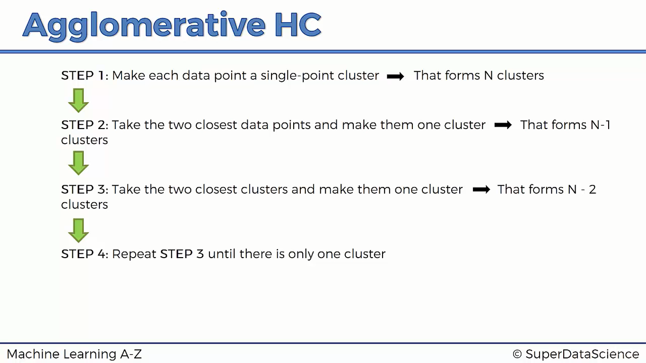

Slide 6
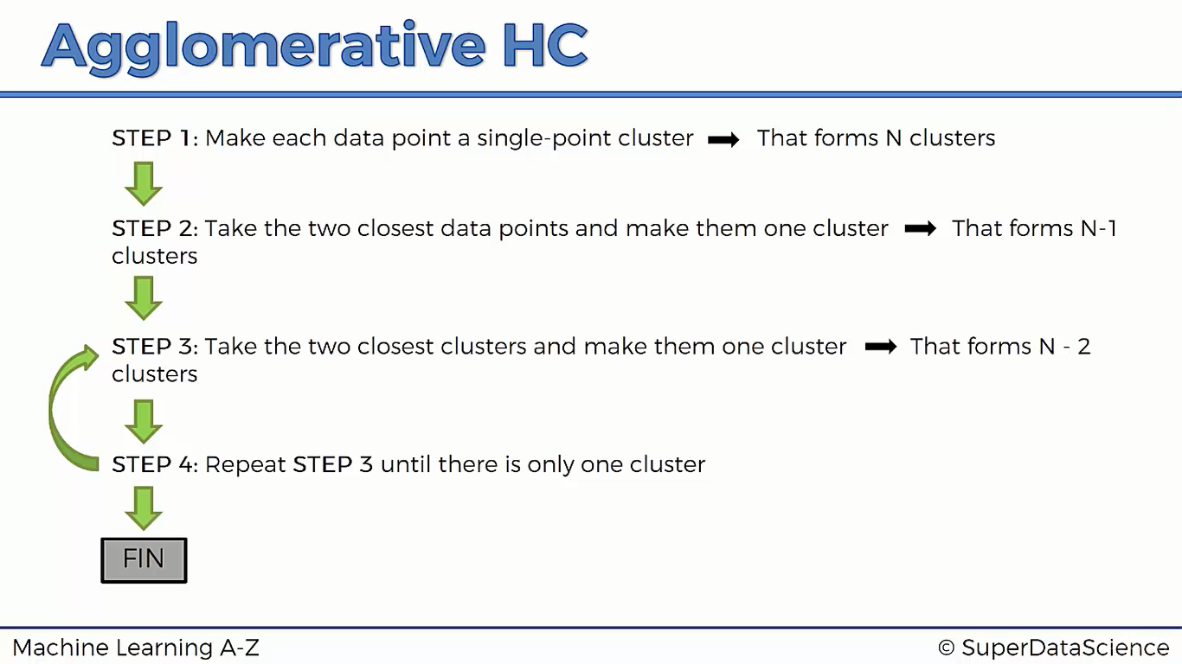

Slide 7
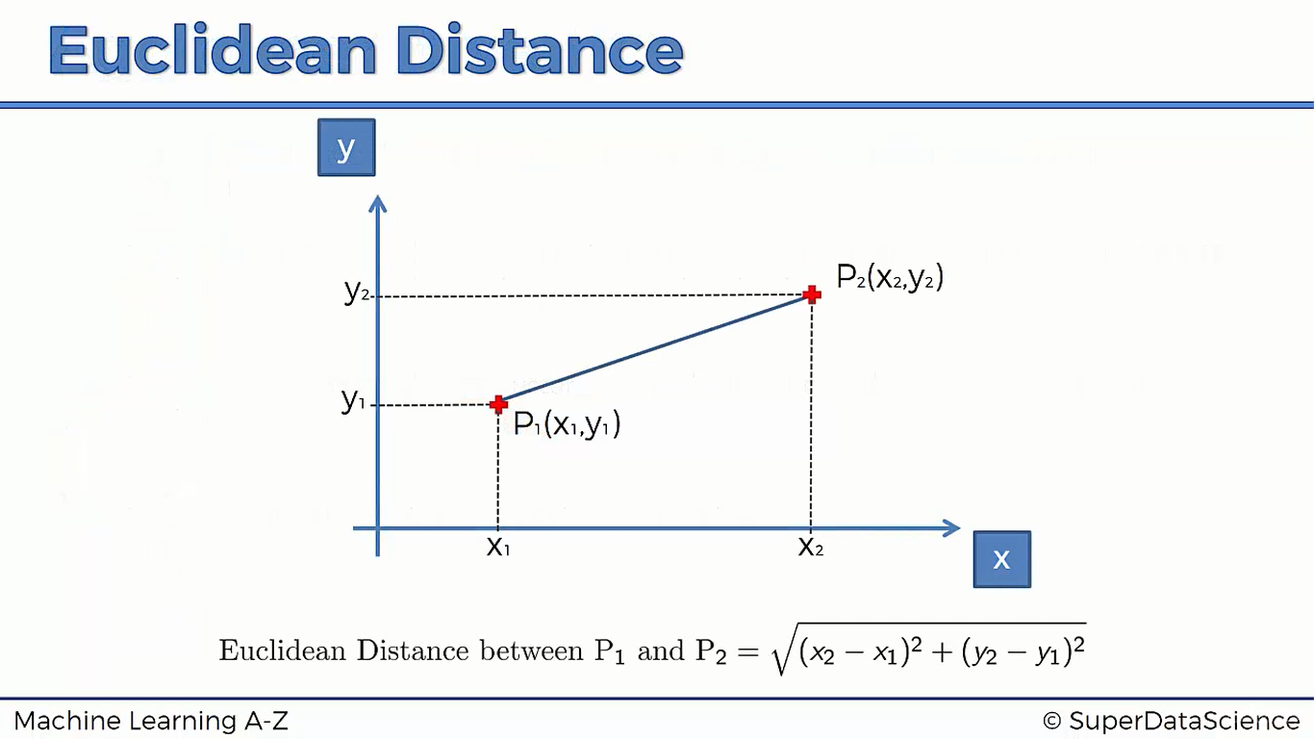

Slide 8
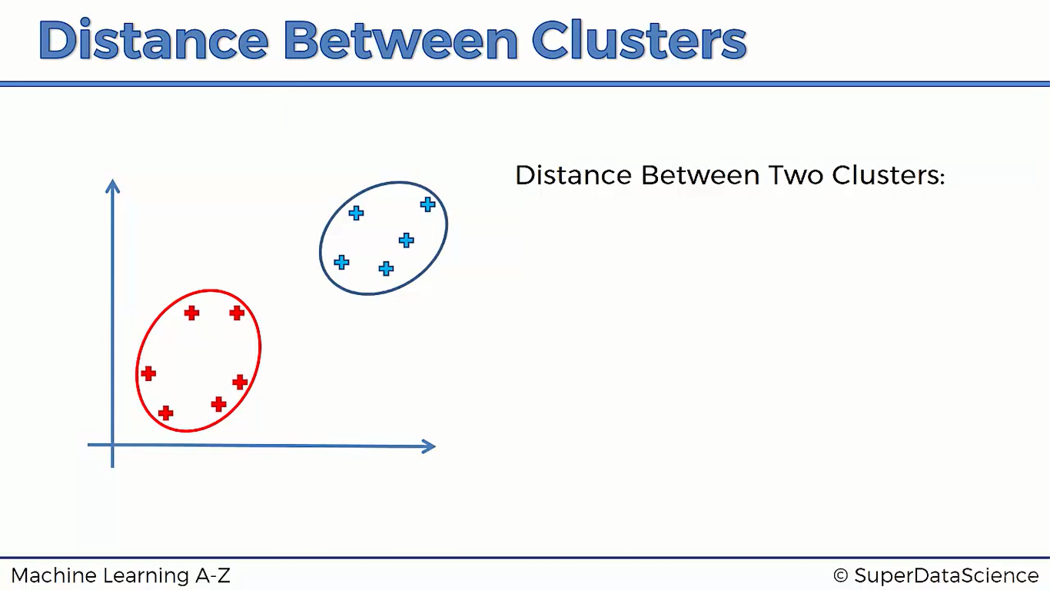

Slide 9
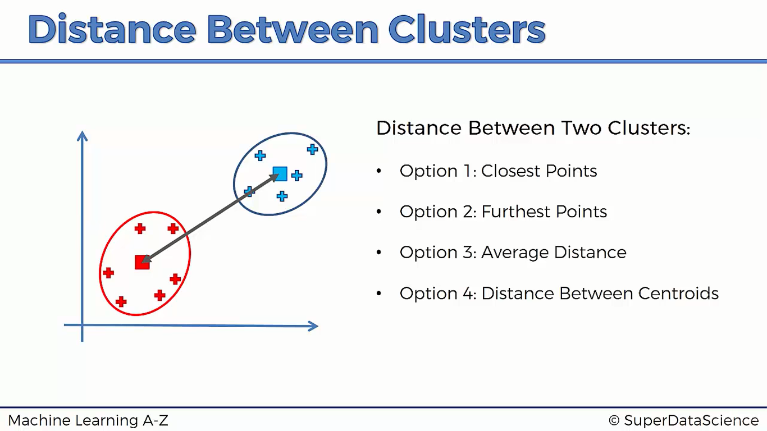

Slide 10
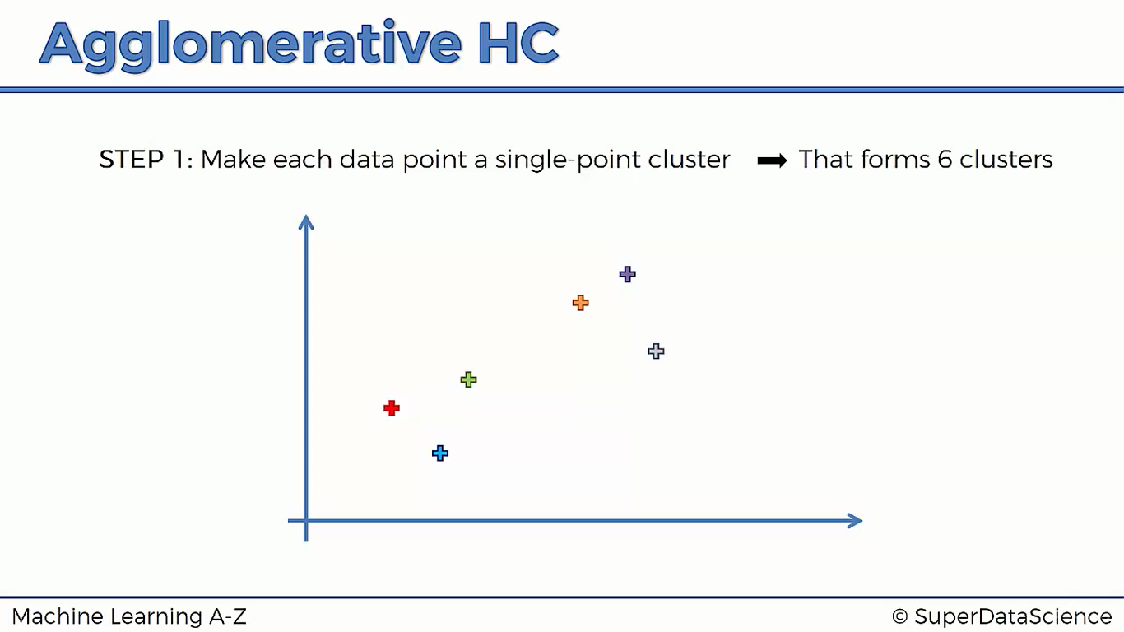

Slide 11
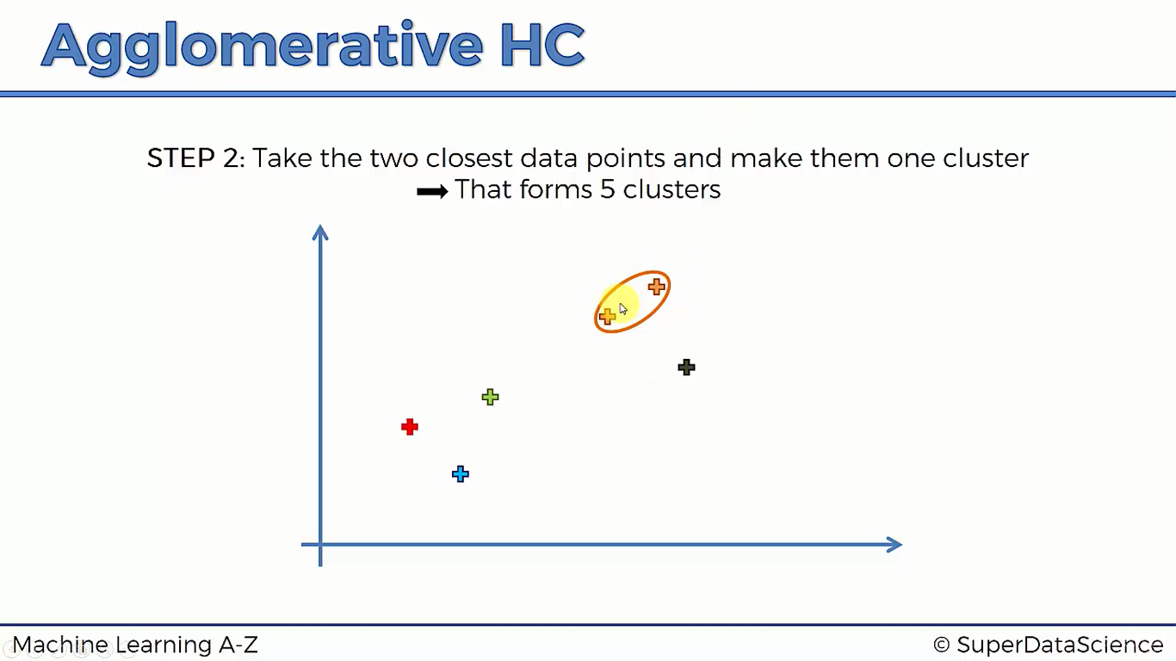

Slide 12
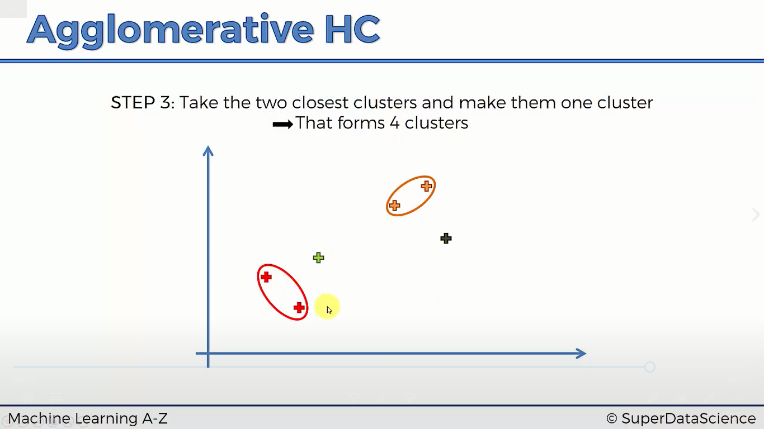

Slide 13
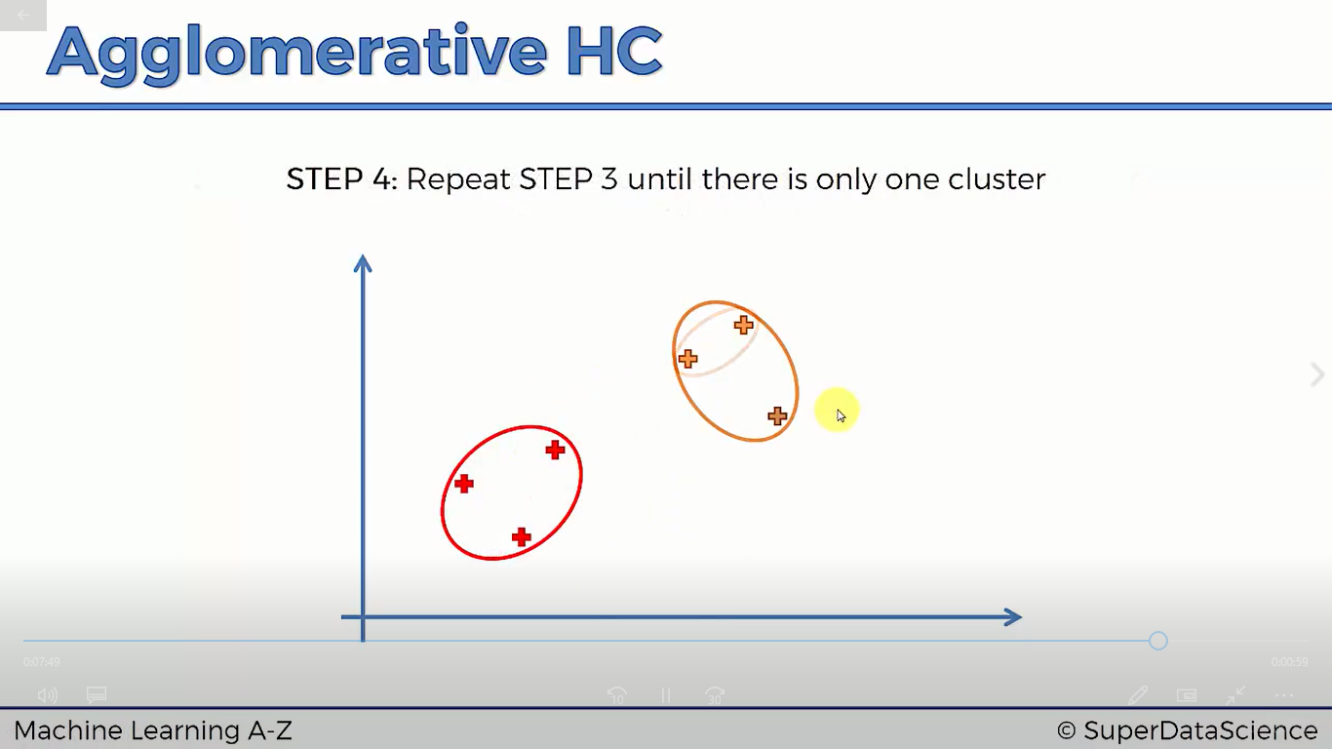

Slide 14
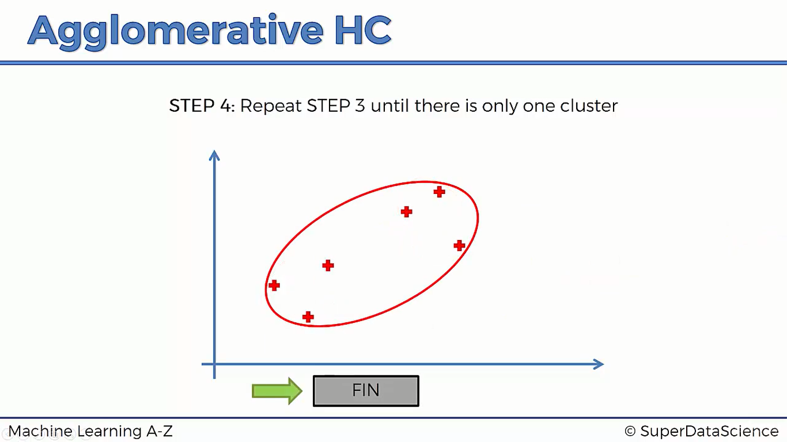

Slide 15
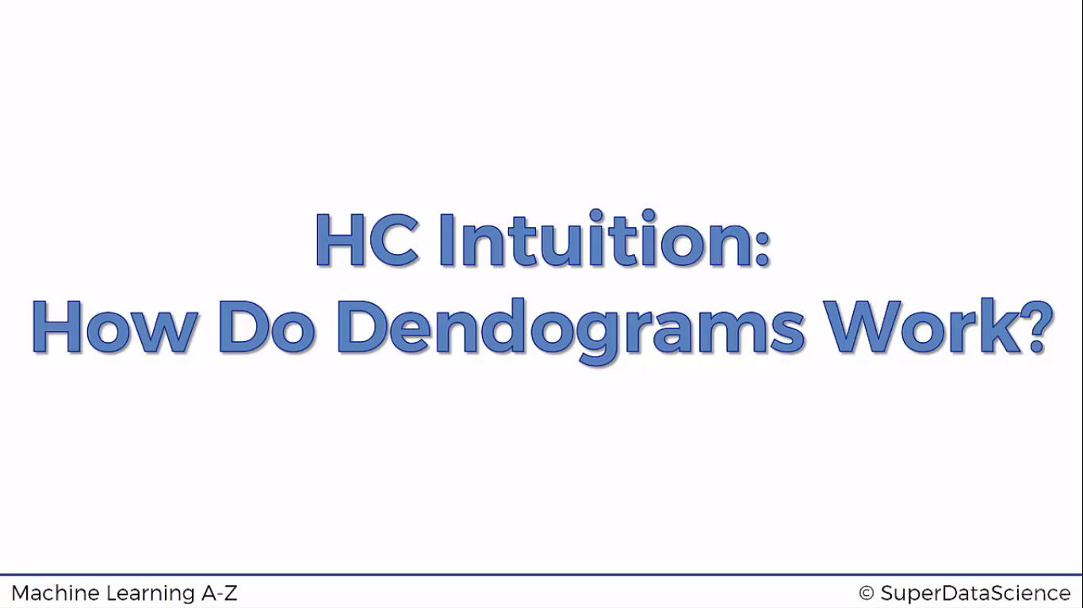

Slide 16
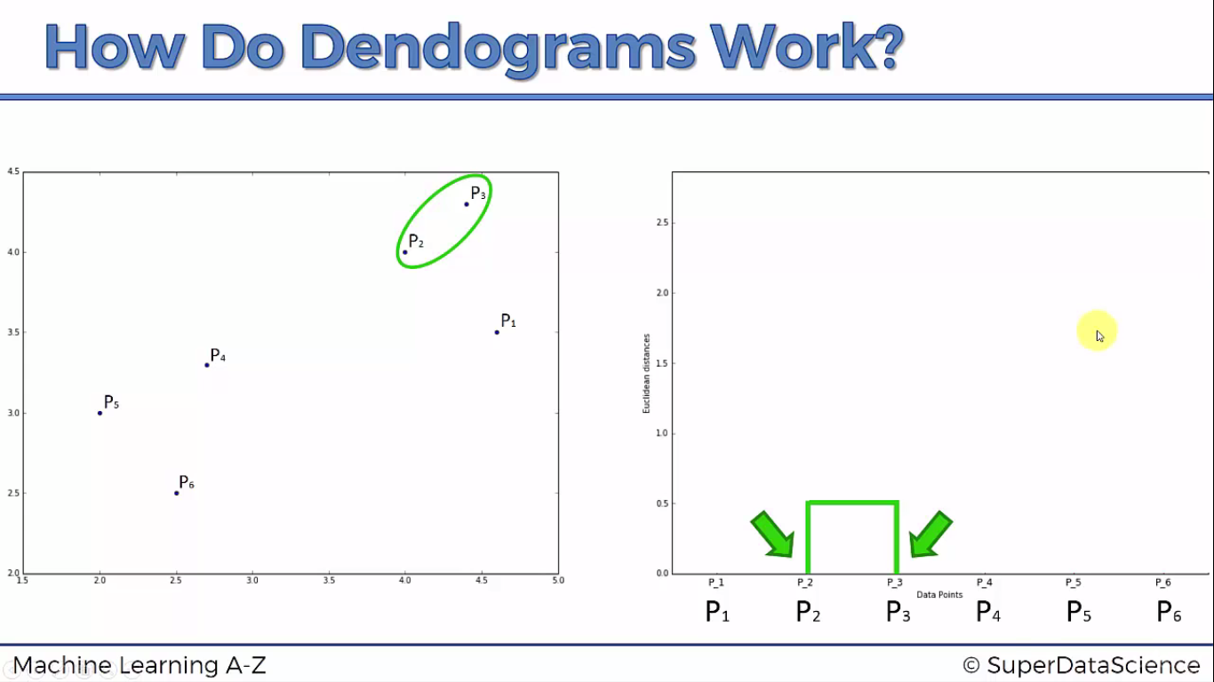

Slide 17
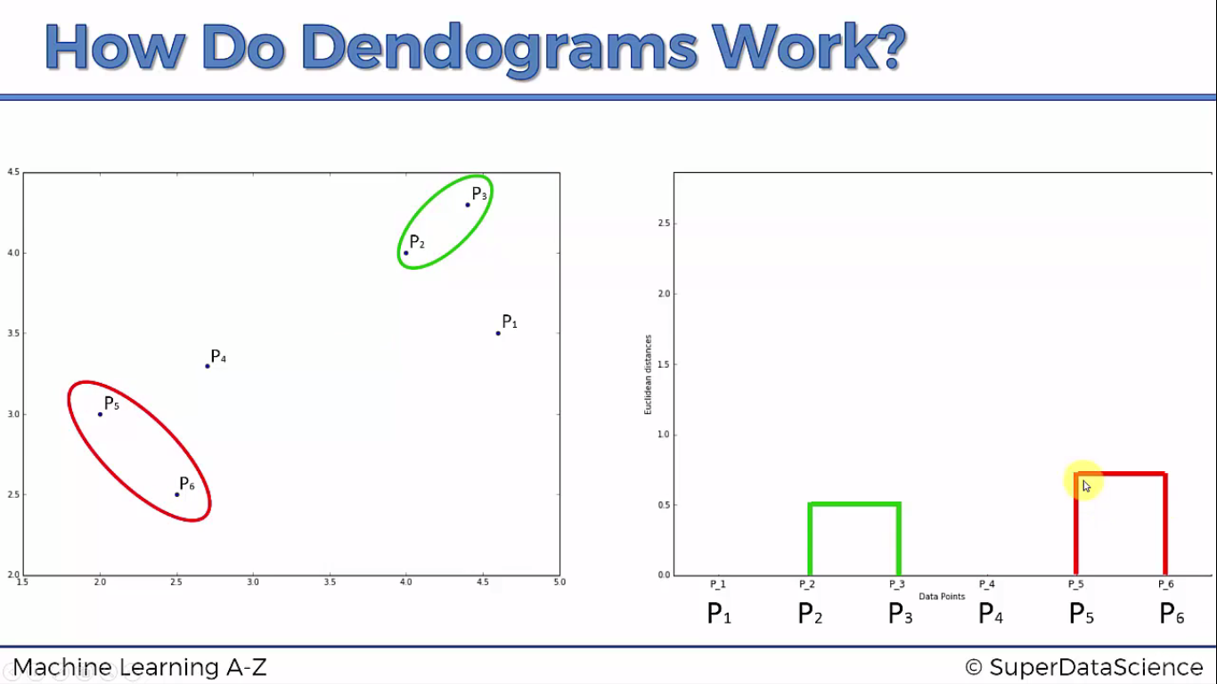

Slide 18
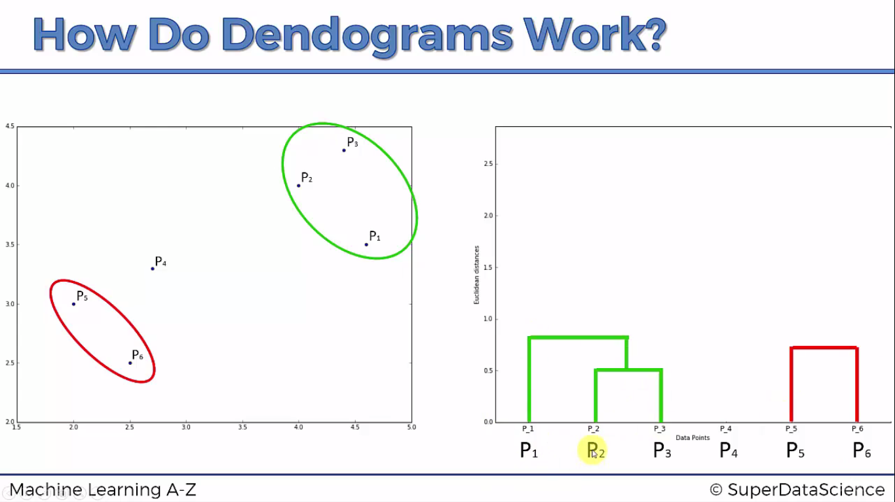

Slide 19
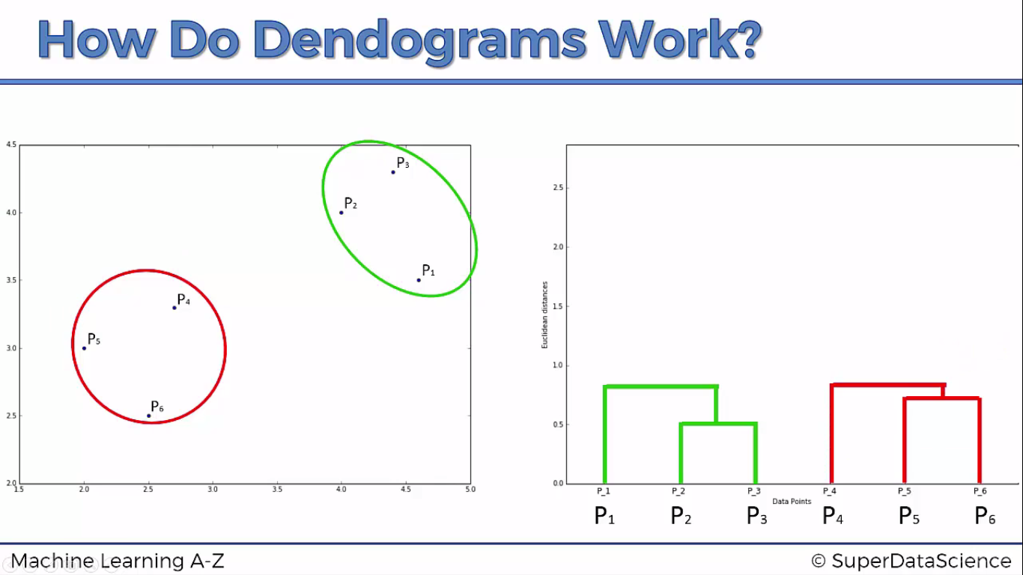

Slide 20
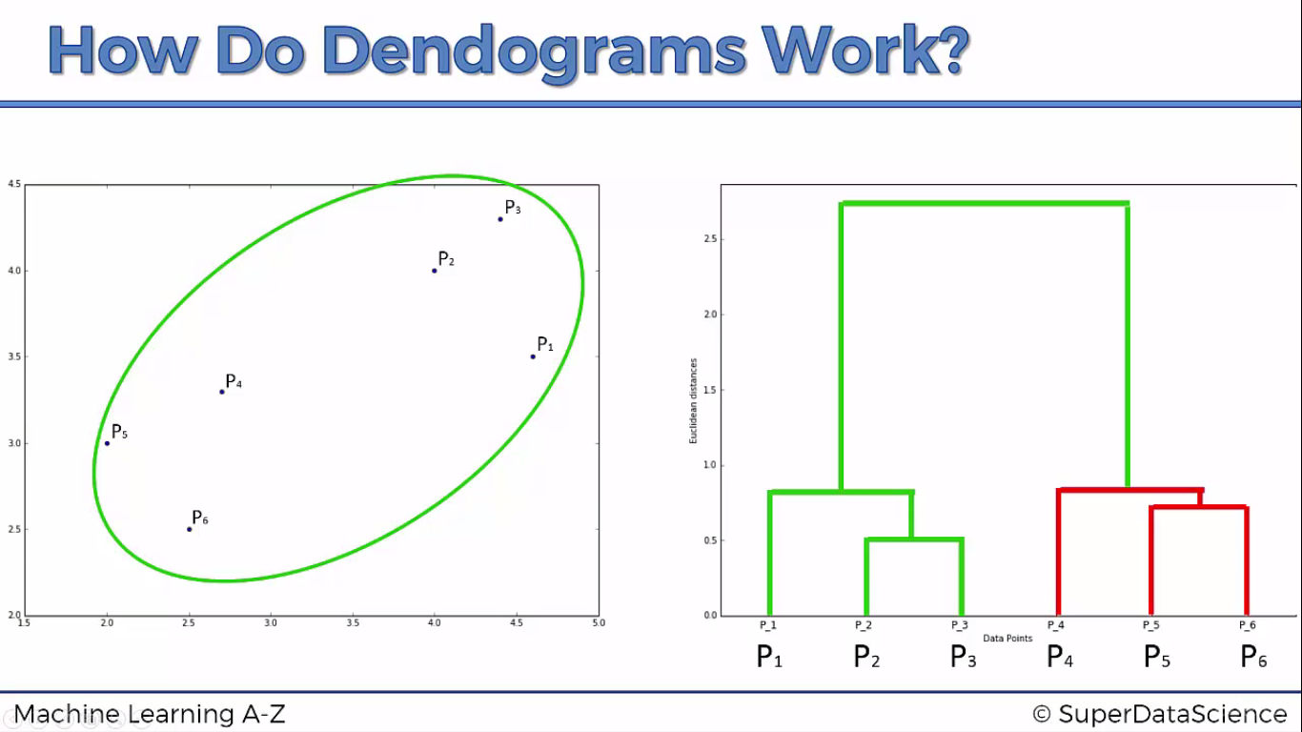

Slide 21
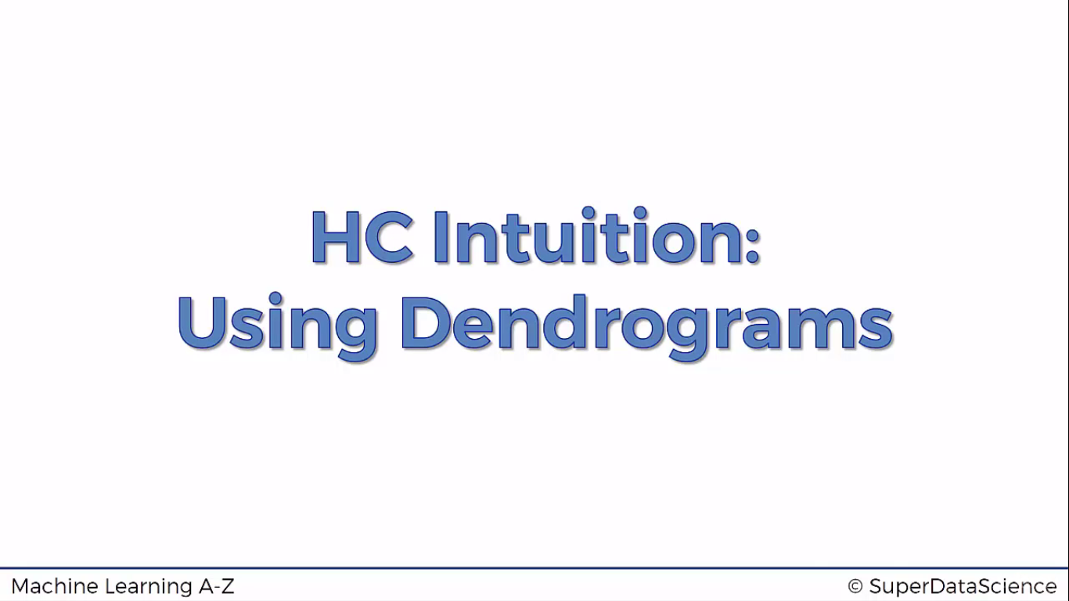

Slide 22
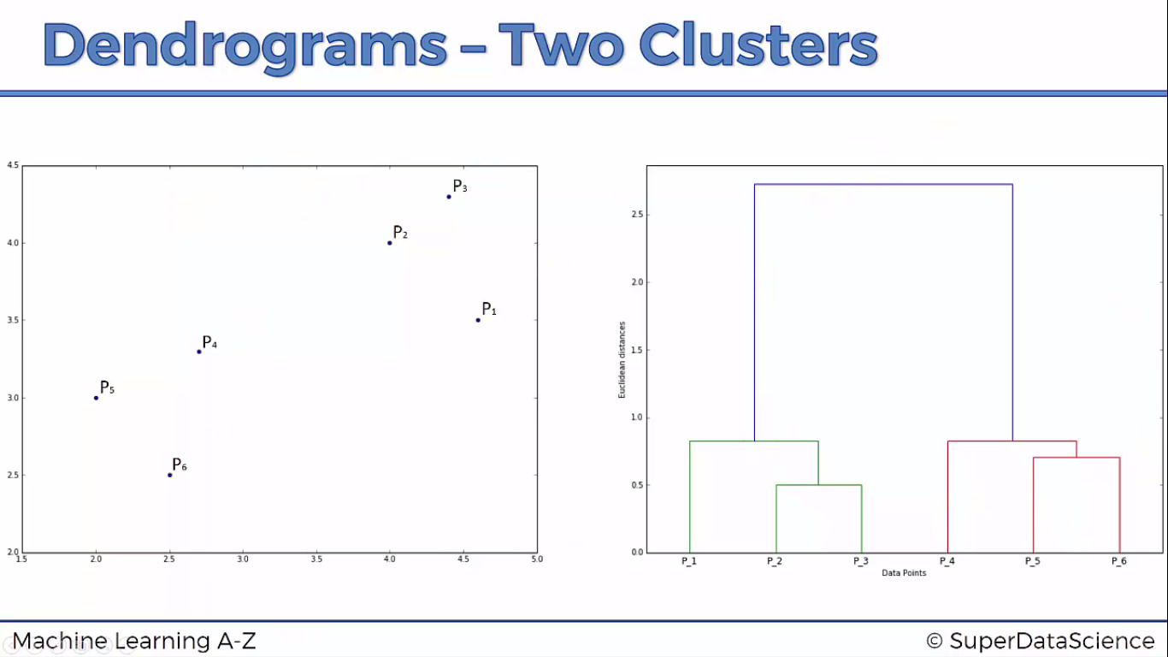

Slide 23
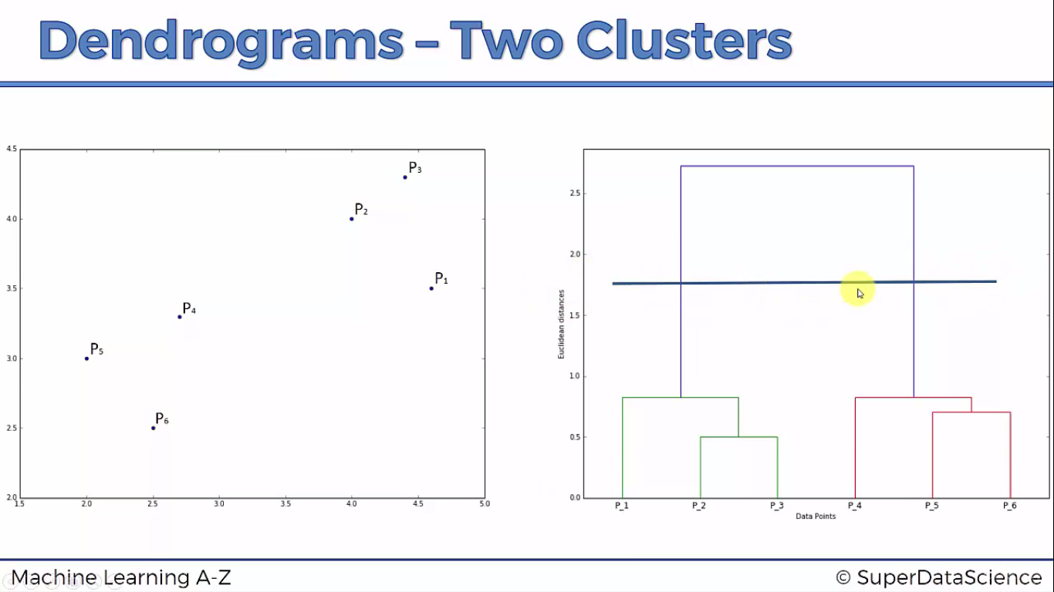

Slide 24
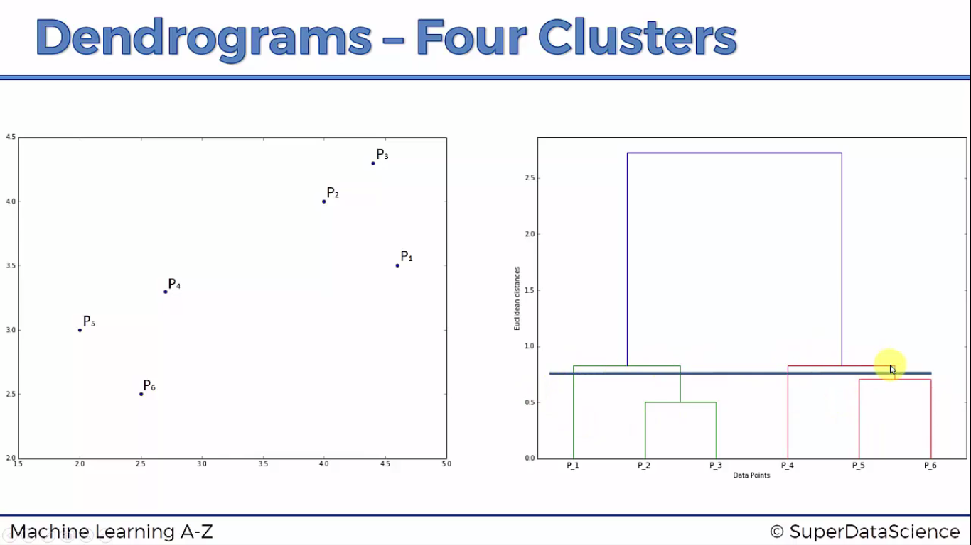

Slide 25
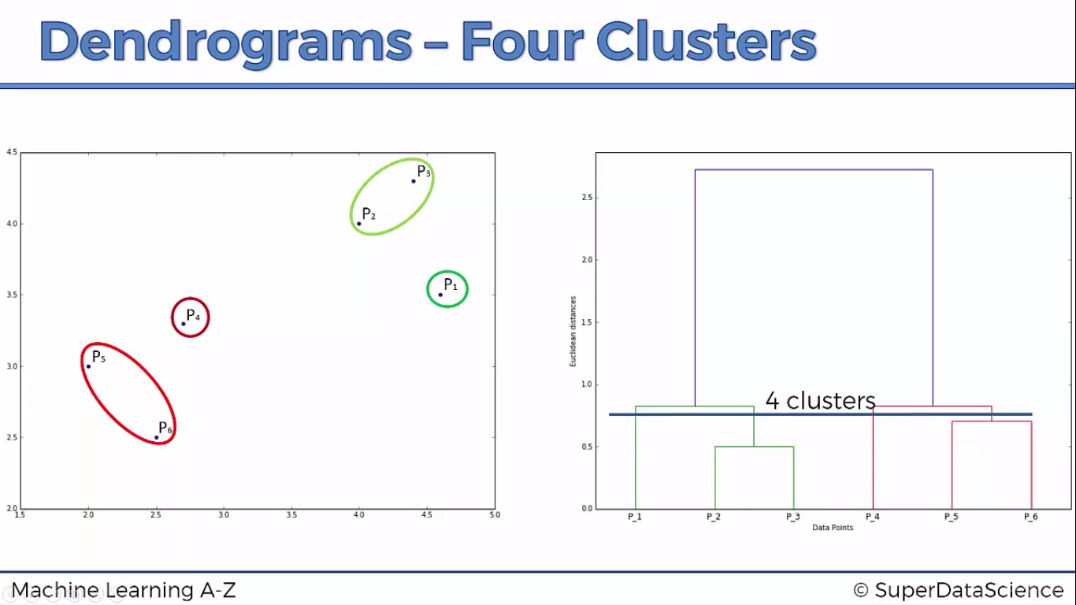

Slide 26
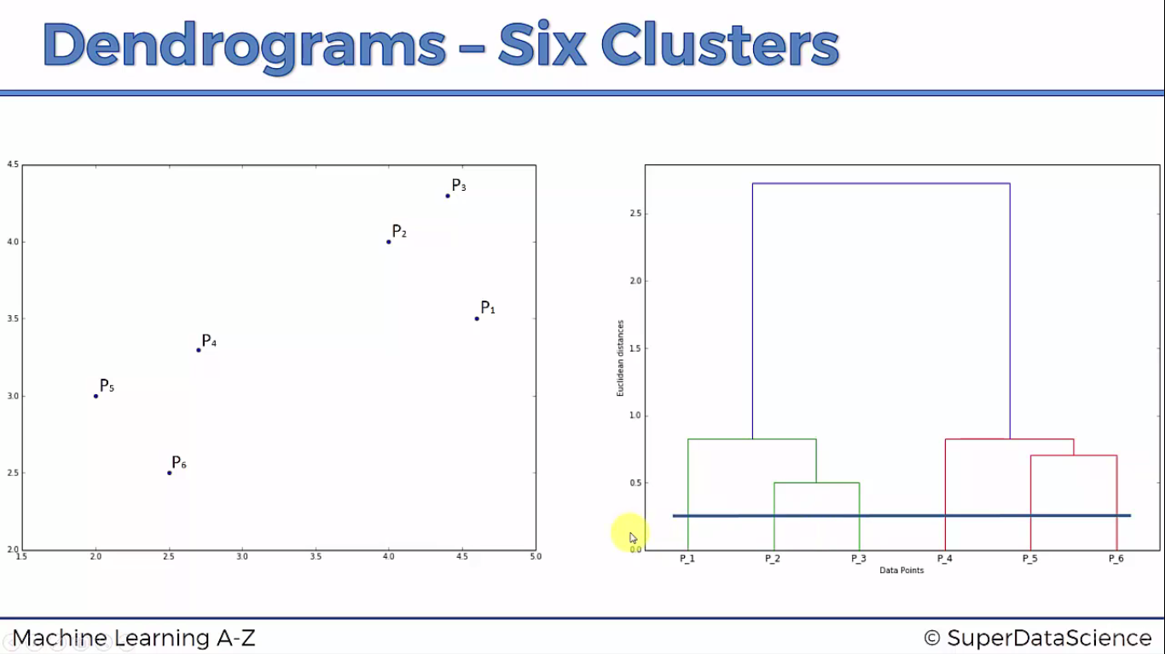

Slide 27
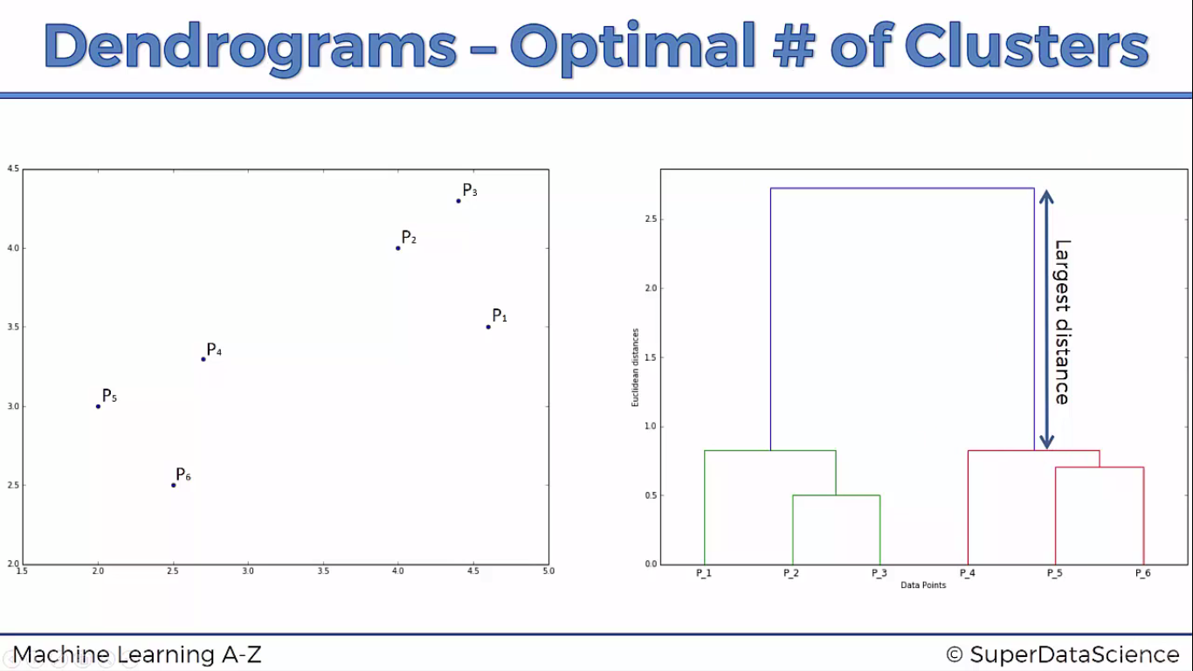

Slide 28
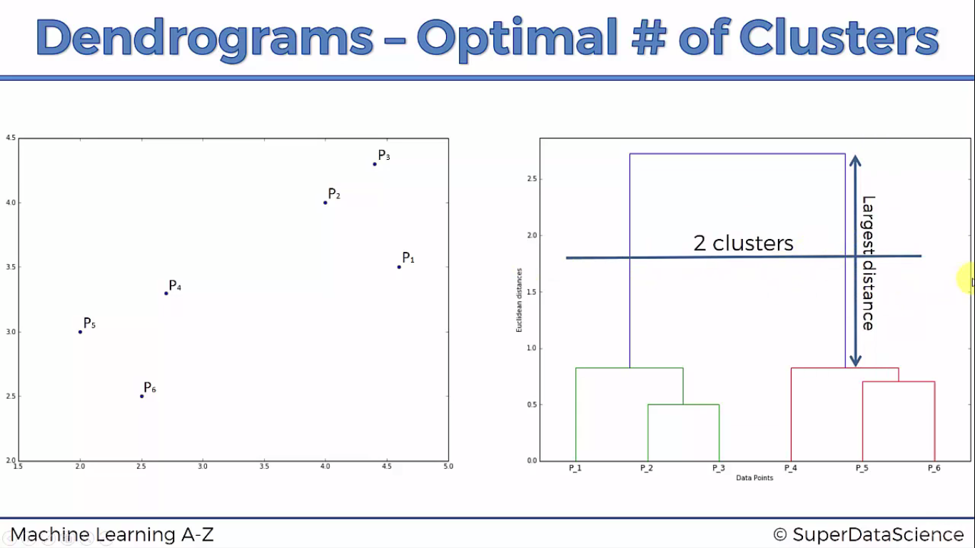

Slide 29
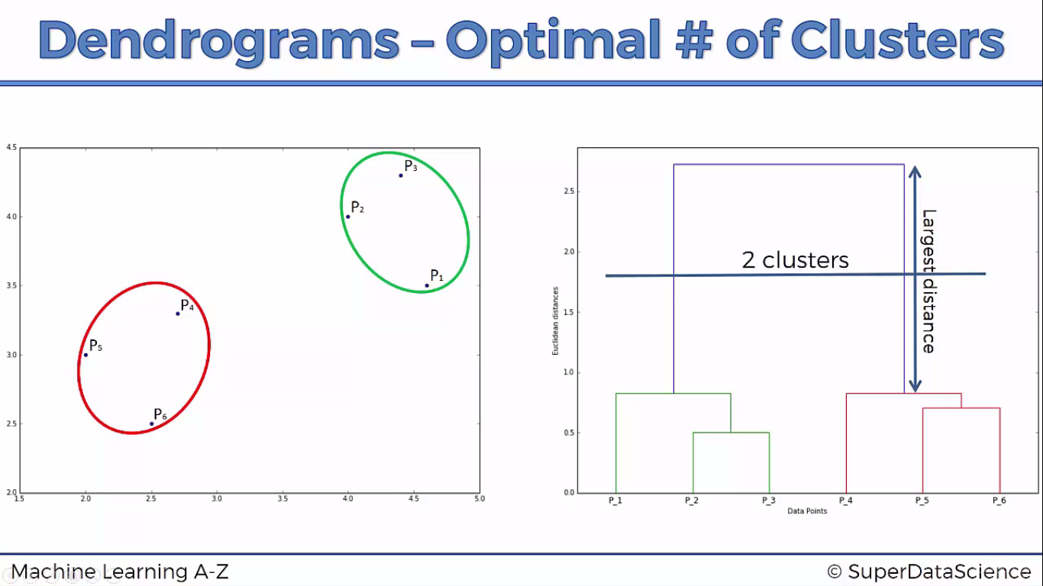

Slide 30
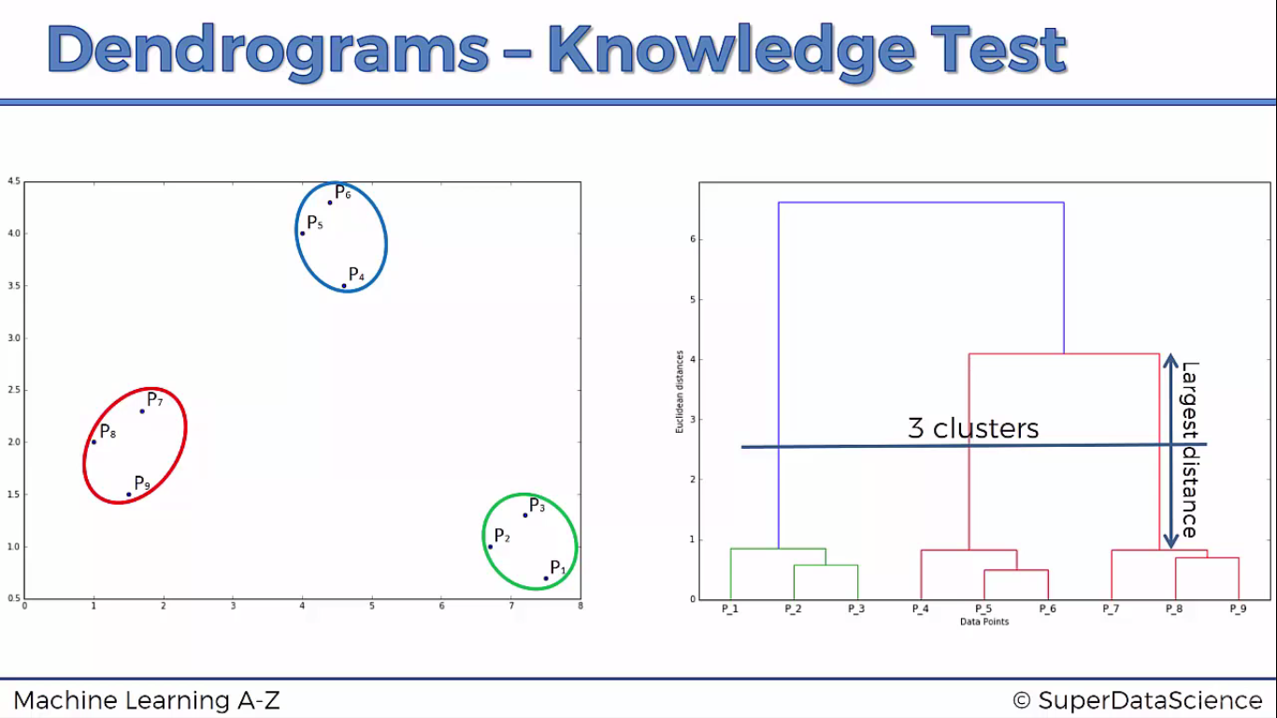

Slide 31

Python

Slide 32
Import librarires
import pandas as pd
import numpy as np
import matplotlib.pyplot as plt

Slide 33
Import dataset
dataset = pd.read_csv("D:/machine learning AZ/Machine Learning A-Z Template Folder/Part 4 - Clustering/Section 24 - K-Means Clustering/K_Means/Mall_Customers.csv")
X = dataset.iloc[:,[3,4]].values

Slide 34
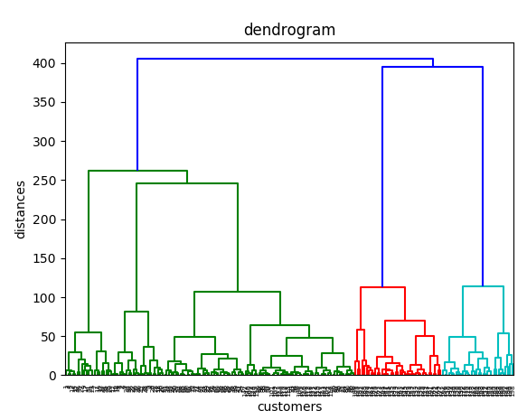
Dendrogram plotting
import scipy.cluster.hierarchy as sch
dendrogram = sch.dendrogram(sch.linkage(X,method = 'ward'))
#ward reduces the variance between the clusters
plt.title("dendrogram")
plt.xlabel("customers")
plt.ylabel("distances")
plt.show()
Note : from this we got the poptimal value of k i.e 5

Slide 35
Agglomerative (bottom up) Clustering
from sklearn.cluster import AgglomerativeClustering
hc = AgglomerativeClustering(n_clusters=5, affinity="euclidean",linkage='ward')
y_hc= hc.fit_predict(X)

Slide 36
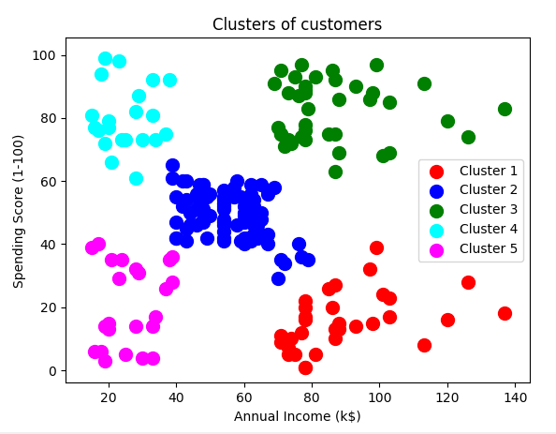
Agglomerative (bottom up) Clustering plot
# Visualising the clusters
plt.scatter(X[y_hc == 0, 0], X[y_hc == 0, 1], s = 100, c = 'red', label = 'Cluster 1')
plt.scatter(X[y_hc == 1, 0], X[y_hc == 1, 1], s = 100, c = 'blue', label = 'Cluster 2')
plt.scatter(X[y_hc == 2, 0], X[y_hc == 2, 1], s = 100, c = 'green', label = 'Cluster 3')
plt.scatter(X[y_hc == 3, 0], X[y_hc == 3, 1], s = 100, c = 'cyan', label = 'Cluster 4')
plt.scatter(X[y_hc == 4, 0], X[y_hc == 4, 1], s = 100, c = 'magenta', label = 'Cluster 5')
plt.title('Clusters of customers')
plt.xlabel('Annual Income (k$)')
plt.ylabel('Spending Score (1-100)')
plt.legend()
plt.show()

Slide 37

R

Slide 38
dataset = read.csv('Mall_Customers.csv')
dataset = dataset[4:5]

Slide 39
dendrogram
dendrogram = hclust(d = dist(dataset, method = 'euclidean'), method = 'ward.D')
plot(dendrogram,
main = paste('Dendrogram'),
xlab = 'Customers',
ylab = 'Euclidean distances')

Slide 40
Fitting Hierarchical Clustering to the dataset
hc = hclust(d = dist(dataset, method = 'euclidean'), method = 'ward.D')
y_hc = cutree(hc, 5)

Slide 41
Visualising the clusters
library(cluster)
clusplot(dataset,
y_hc,
lines = 0,
shade = TRUE,
color = TRUE,
labels= 2,
plotchar = FALSE,
span = TRUE,
main = paste('Clusters of customers'),
xlab = 'Annual Income',
ylab = 'Spending Score')

